Slide 1

CYBER
SECURITY IN
NEPAL
By: Sushil Phuyal
cisco cyber ops, and security lead at ITSNP

Slide 2

Who am I?
I am Sushil Phuyal, an ethical hacker and cyber security lead at IT students of Nepal working on cyber security moment around Nepal.

Slide 3

What is hacking?
Unauthorized access to network or system.
Exploiting misconfiguration, security controls or vulnerable services.
It has more illusions than facts.
“If something looks like spell in today’s world, then it’s exploit.”

Slide 4


Common attacks
Phishing and vishing.
DNS/ARP attacks.
Mail spoofing.
Password protection.
Social media threats.
Torrenting and ransomware.

Slide 5
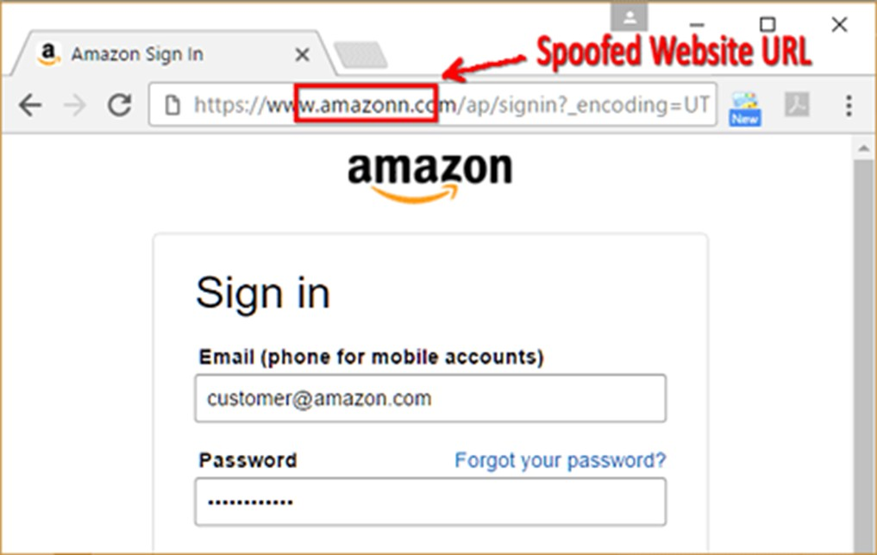
Phishing attacks
Phishing are similar looking sites to trap a victim. also has other forms of phishing like vishing to occur these days on WhatsApp.

Slide 6
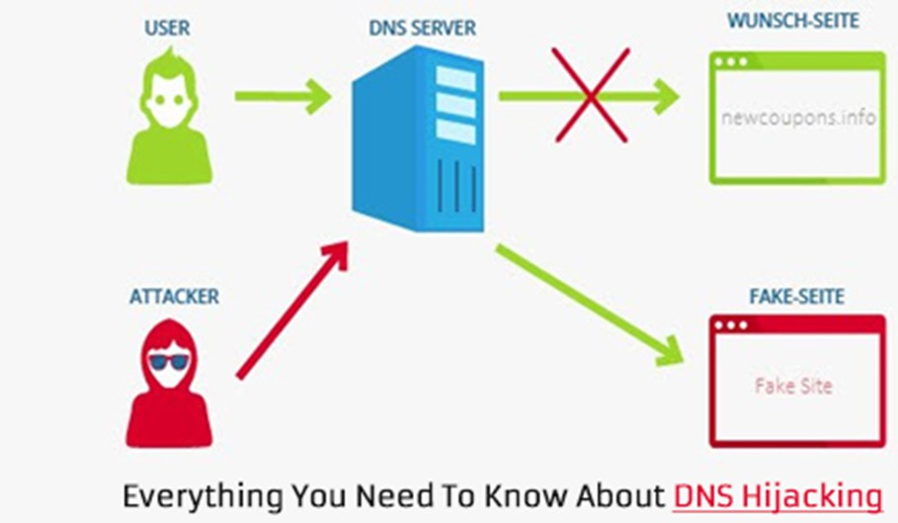
DNS Spoofing
DNS is domain naming service and confusing it is DNS hijacking or spoofing attack mostly common on public wifi.

Slide 7
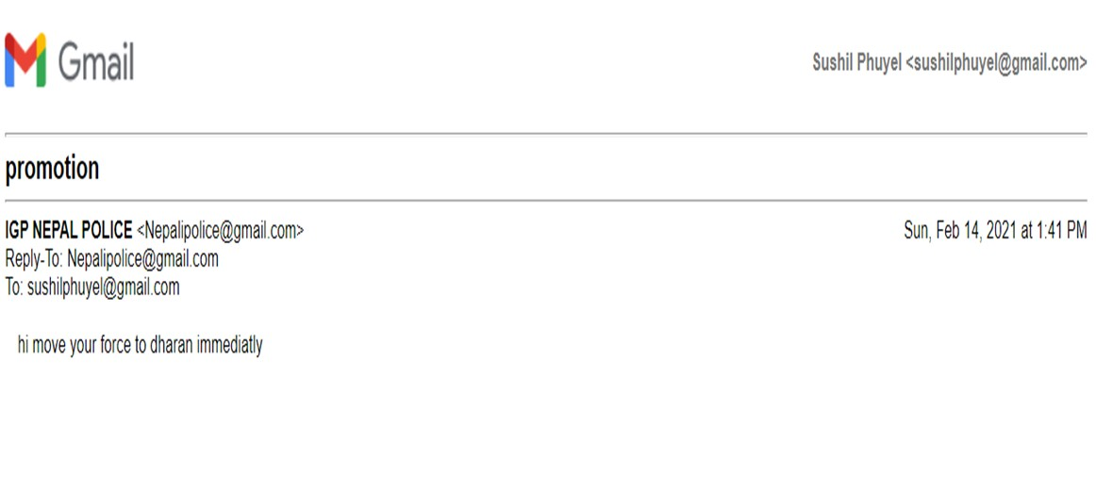
Mail spoofing
mail spoofing are ultered mail from their mail servers, resulting on victim to fall onto it.

Slide 8


Slide 9
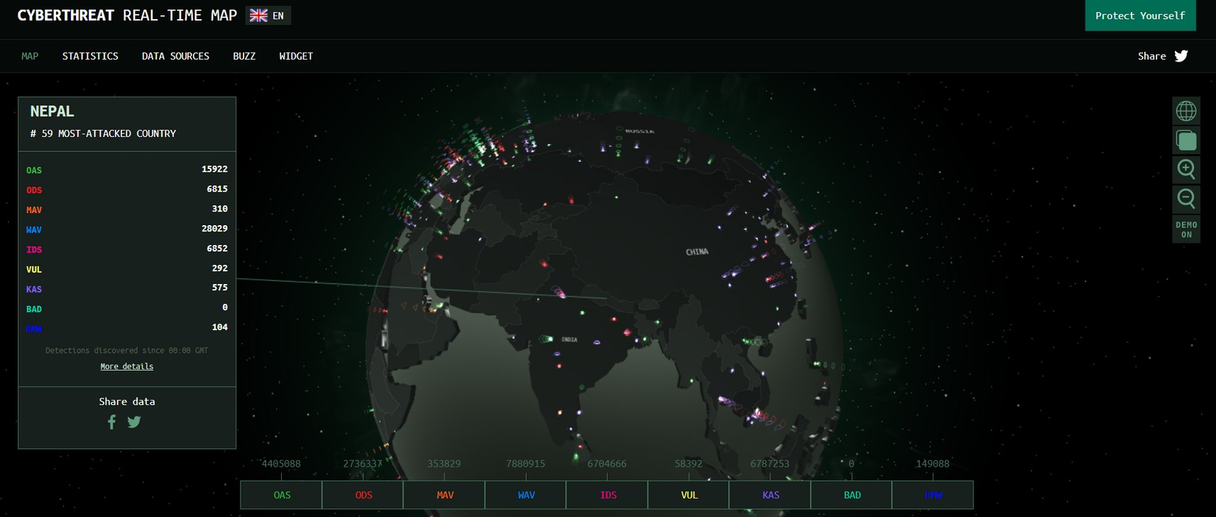
Why is security important?

Slide 10
3.5 Billions google search in a day
205 Billion mails are sent everyday.
30 billions messages send in whatsapp in a day
8.4 billions youtube videos watched

Slide 11


Social media threats
Scam
Blackmailing
Harassments
Ransome
Identity theft

Slide 12

Torrenting and ransomeware threats
Ransomware
Malware
RAT

Slide 13

Teen attraction to blackhat attacks
its not about others its about you!

Slide 14

Ignorance of law is never an excuse!

Slide 15



Stay safe next might be you!

Slide 16


Slide 17


Thank you!

